Slide 1
Last meeting follow-up:
Referencing – online: changes between labs, depends on the software. Offline: researchers re-referenced using Left and right mastoid channels. For KENT lab I used A1+A2.
Every raw data file is the complete recording of a participant’s session, during which the participant read 80 sentences.
ICA - decomposes a complex, multi-channel EEG signal into its distinct, statistically independent source components. Allows us to isolate the specific electrical signature of eyeblinks into dedicated components, which can then be cleanly subtracted from the dataset while preserving the underlying neural activity.
ERP maps – are the average of all the cloze-noun sentences.

Slide 2
Processing pipeline:
Import Data: Load the raw EEG recording file into EEGLAB.
Channel Locations: Assign standard 10-20 system coordinates to all electrodes.
Re-reference: Re-reference the data to the average of the mastoid electrodes (A1 and A2).
Condition Selection: Filter the relevant sentences for analysis by selecting their specific trigger codes (S205 – expected noun).
Epoching: Extract data segments (-1.0 to 0.5 seconds) strictly around the sentence markers selected in the previous step.
Baseline Correction: Apply baseline correction using the appropriate pre-stimulus time window (-1000ms to -500ms).
Run ICA: Perform Independent Component Analysis to separate the EEG signal into independent sources.
Reject Artifacts (ICA): Identify and remove ICA components representing eye blinks and movements.
Reject Extreme Values: Delete remaining noisy epochs that exceed a voltage threshold of ±100 µV.
Save & Export: Save the clean dataset and export the trial-by-trial data to match with the sentence Cloze probabilities for statistical analysis.

Slide 3
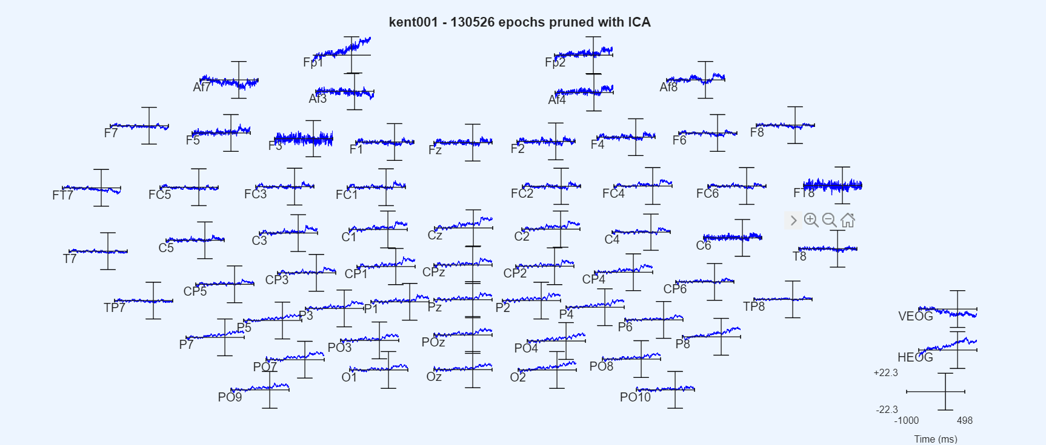
Plot ERP (rectangular array) – focus on Pz, Cz, CP1, CP2 electrodes

Slide 4
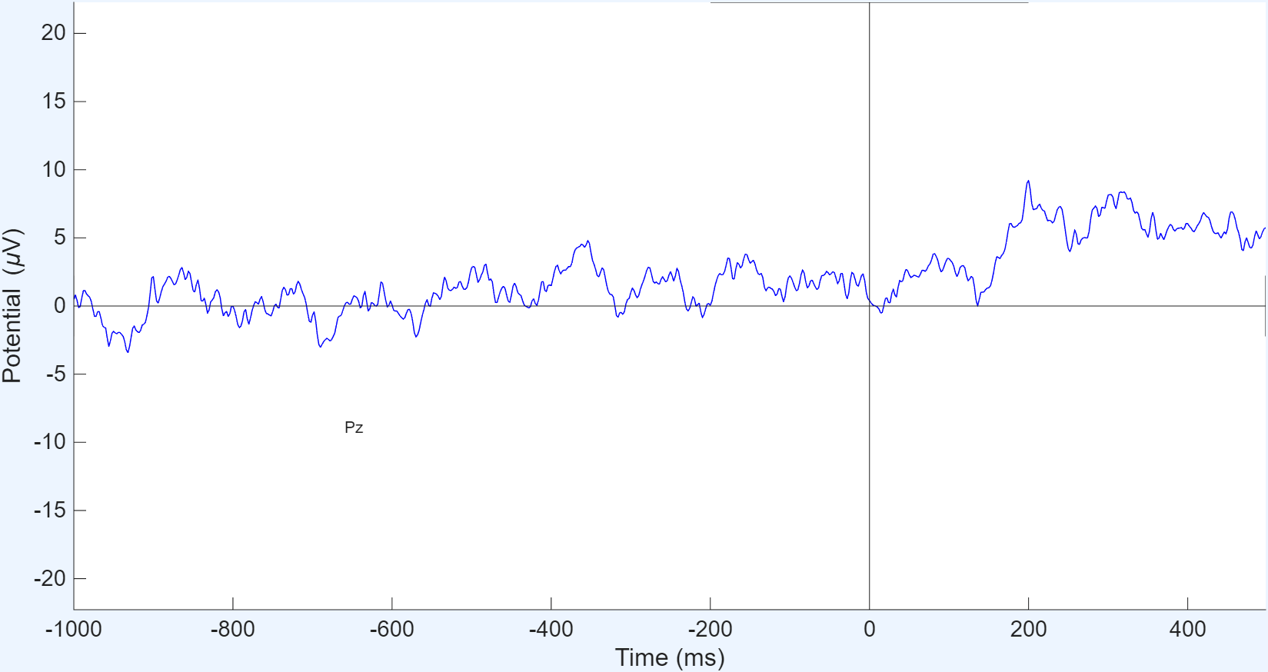
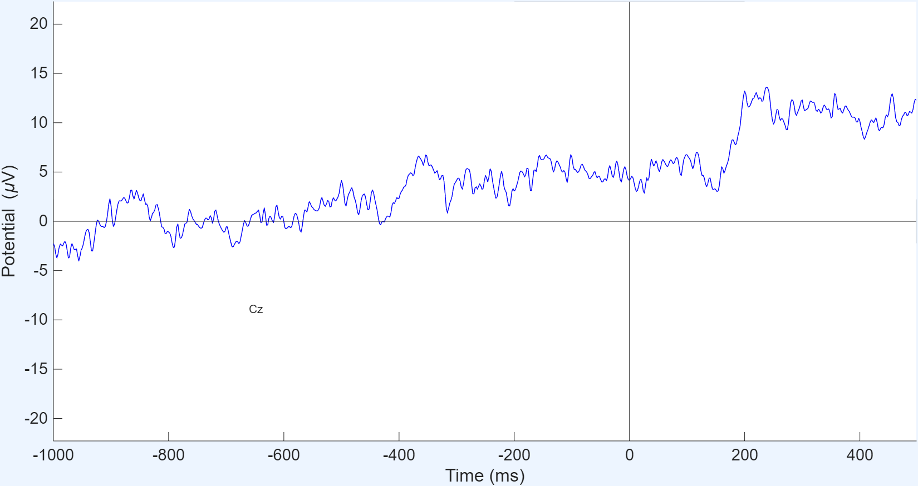
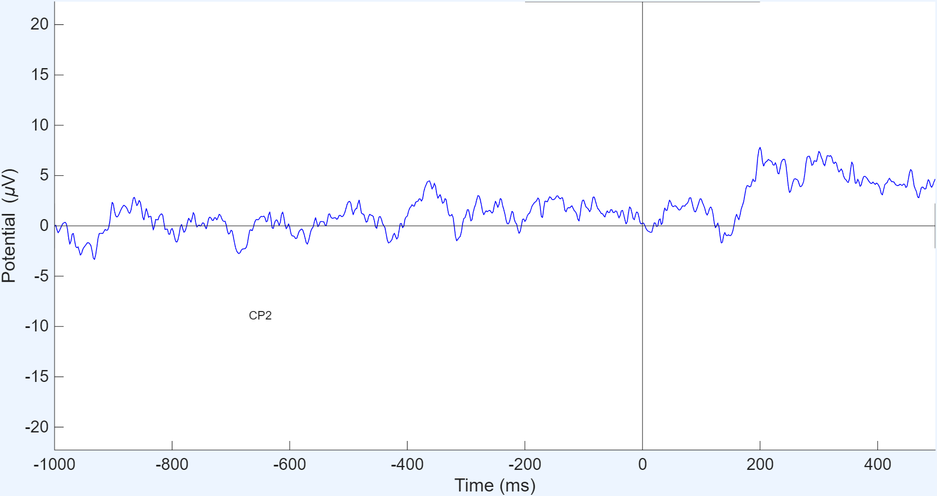
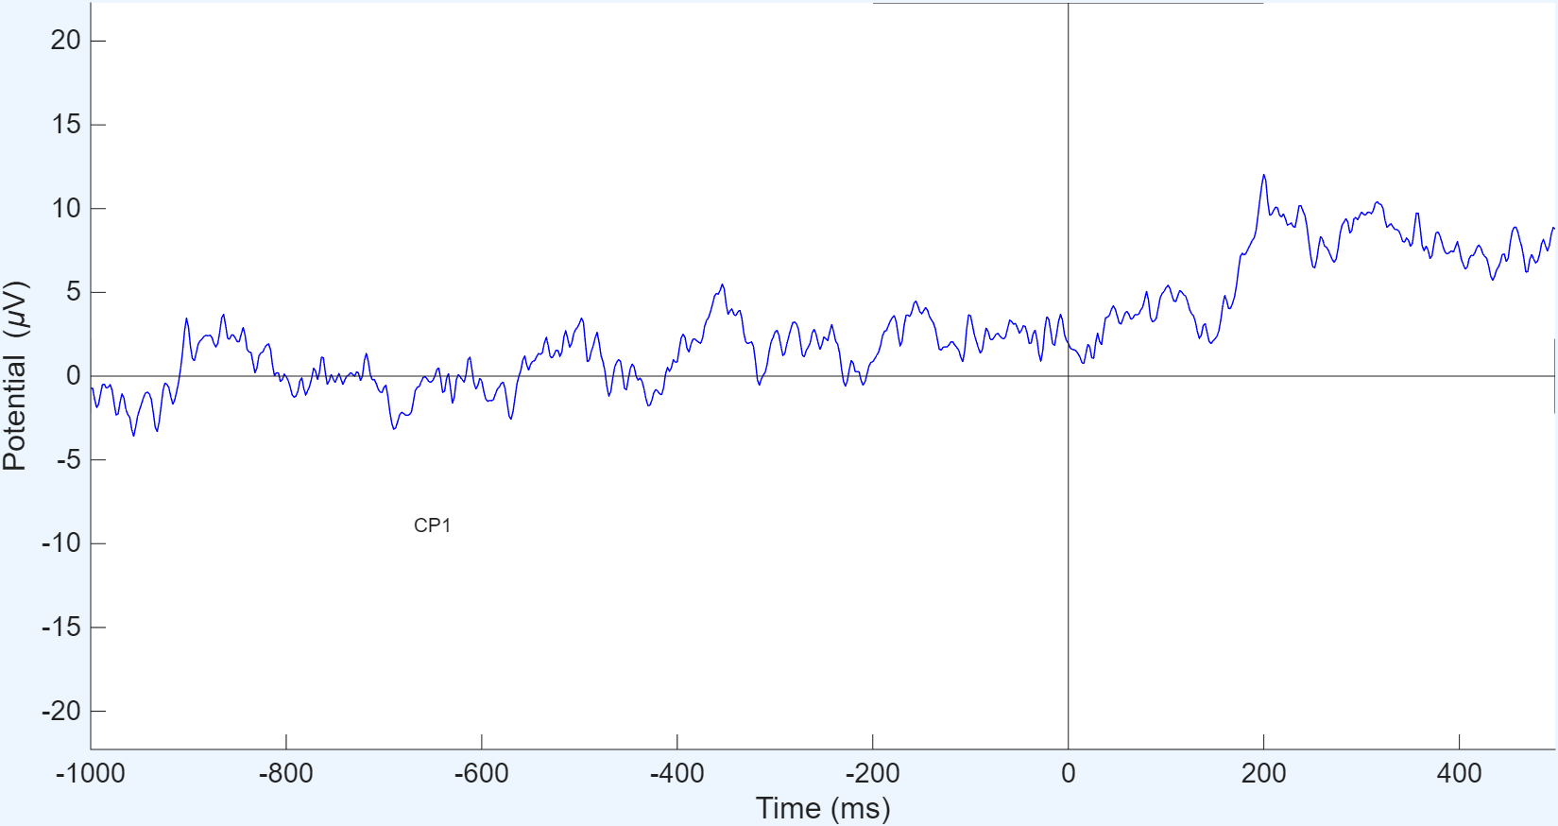
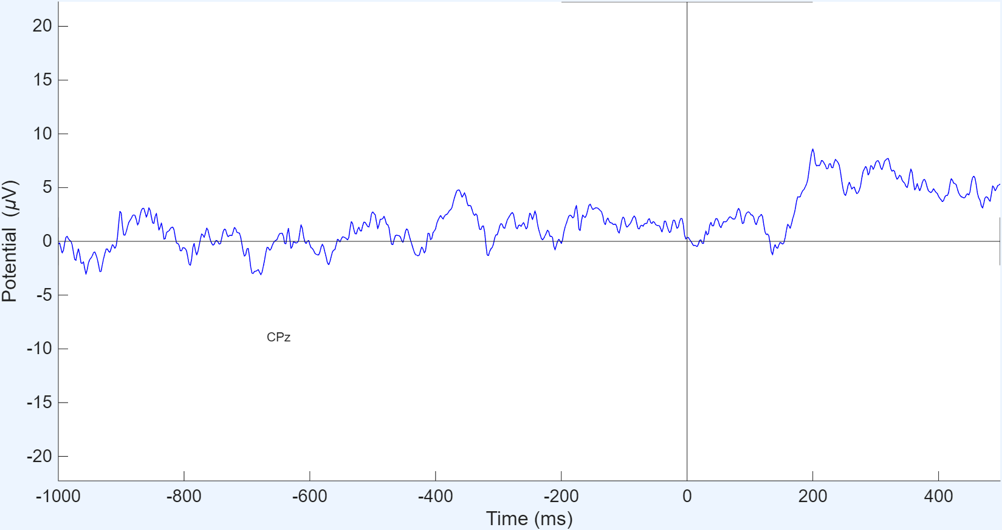
Plot ERP (rectangular array) – focus on Pz, Cz, CP1, CP2 electrodes
After interpulation

Slide 5
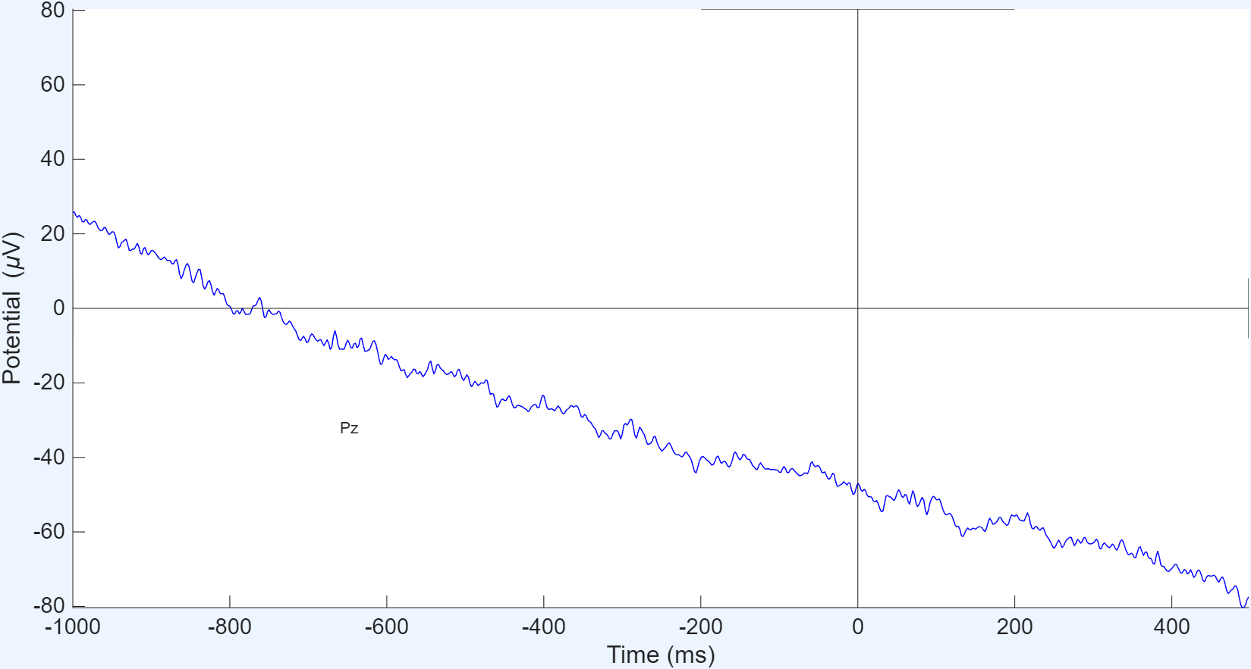
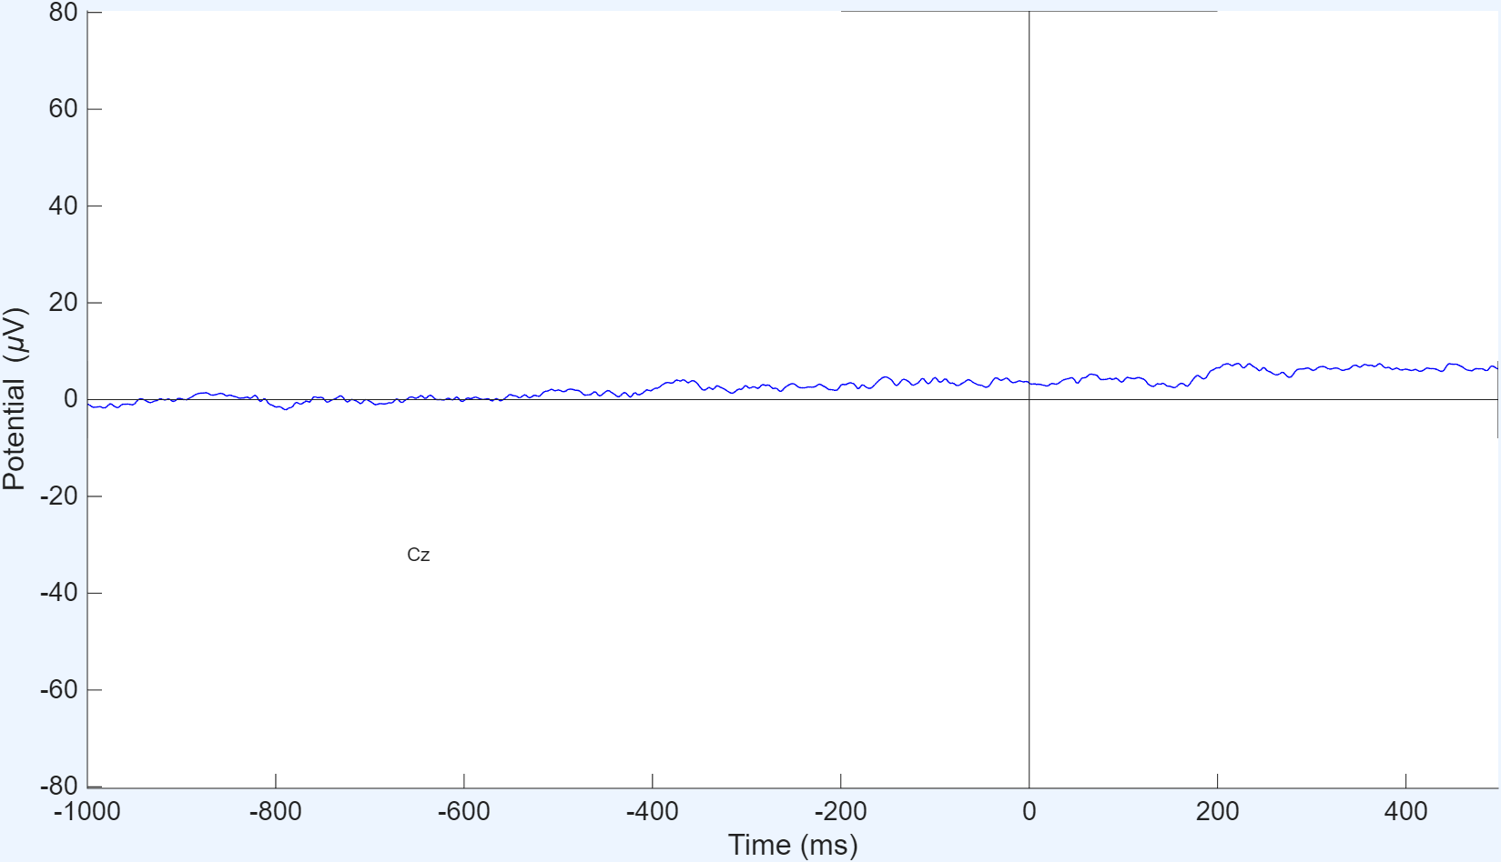
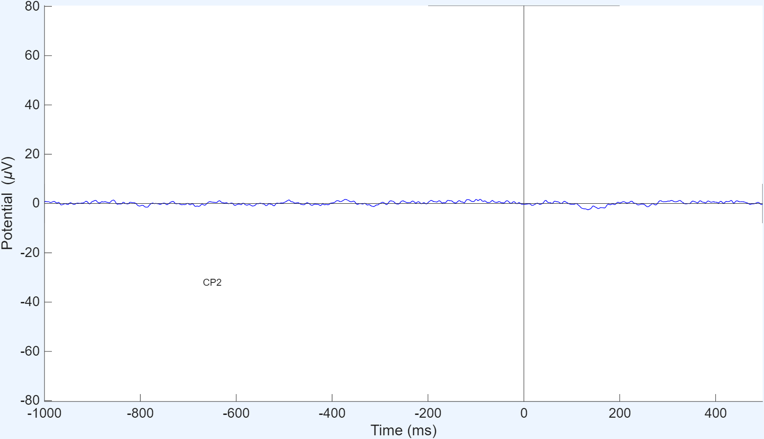
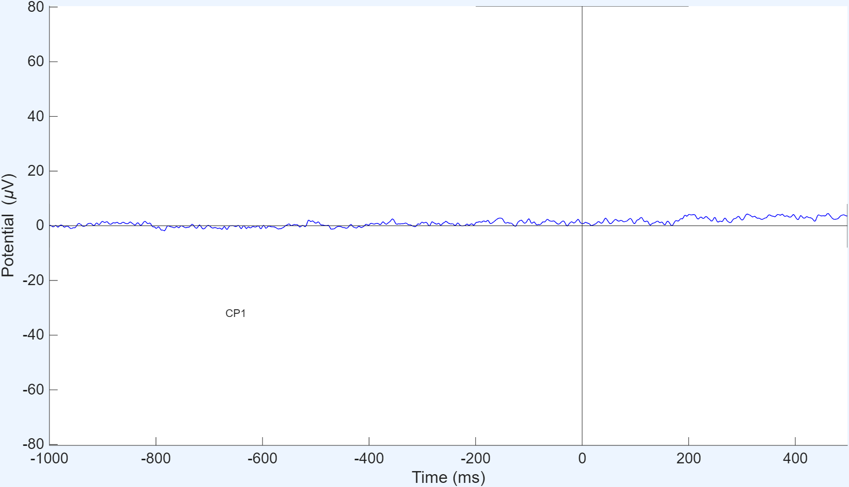
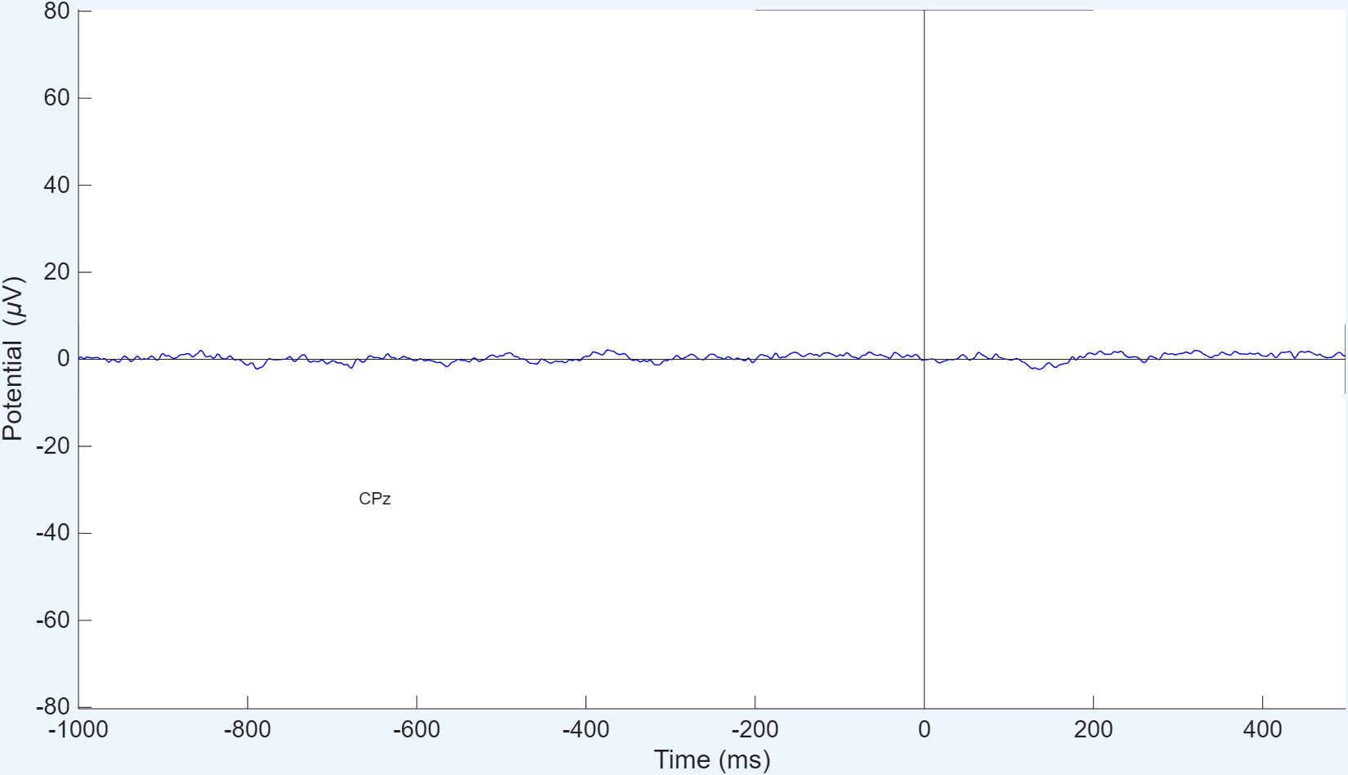
Previous results
Should Interpolate electrode?

Slide 6
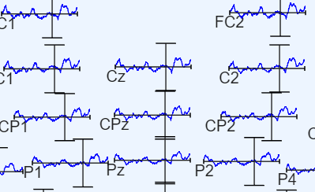
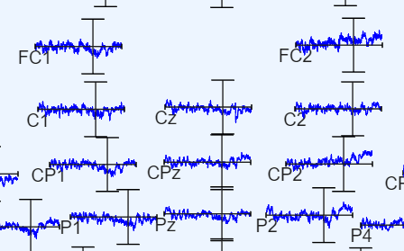
KENT002
KENT003

